Slide 1
Ecological footprint
READING 990-018
Instructor: Maria E. Griffith
By: Chuan Gao
November 26, 2014

Slide 2
definition
the impact of a person or community on the environment, expressed as the amount of land required to sustain their use of natural resources.

Slide 3
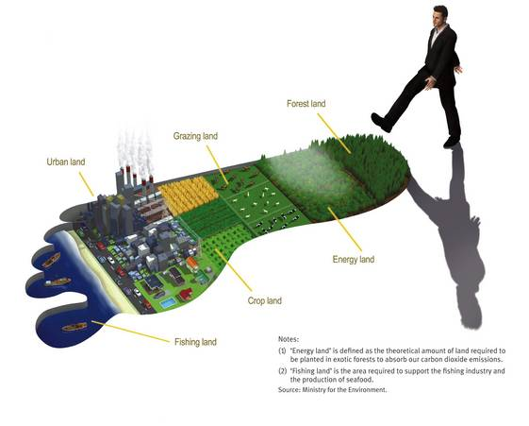
Food
Energy
Water

Slide 4
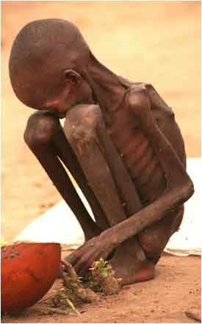
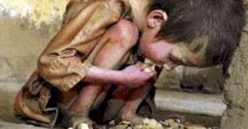
food
- Lack of food
- In a war
- Population
- Natural Disasters

Slide 5
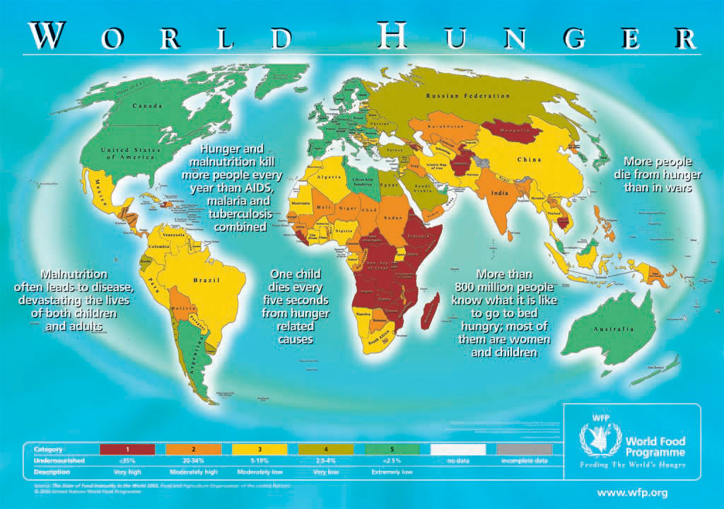
There are almost 900 million people suffering famine.

Slide 6
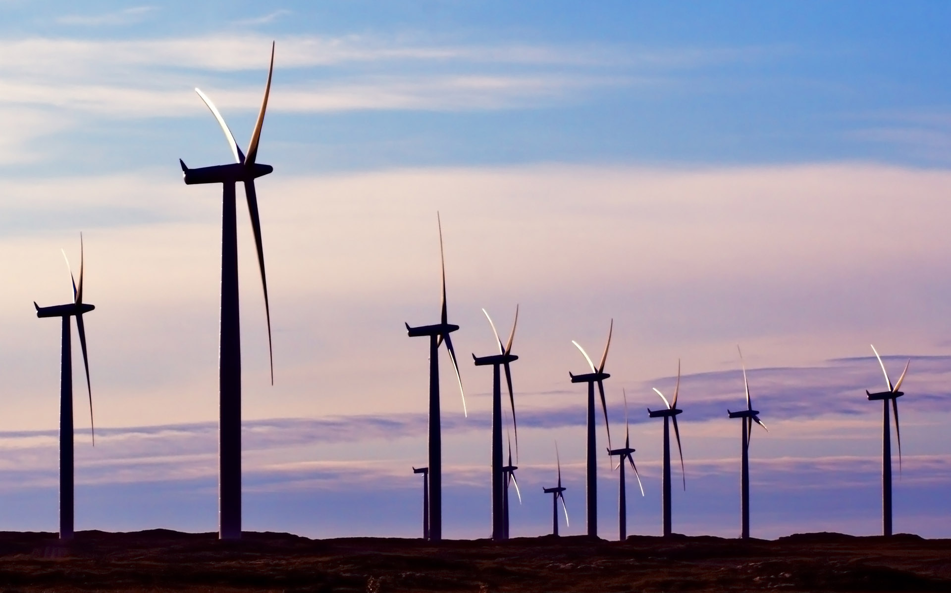
energy
Solar
Wind
Fire
Wave
Biomass technologies

Slide 7
Best energy
hydrogen power
Can be refilled
Zero pollution
High energy

Slide 8
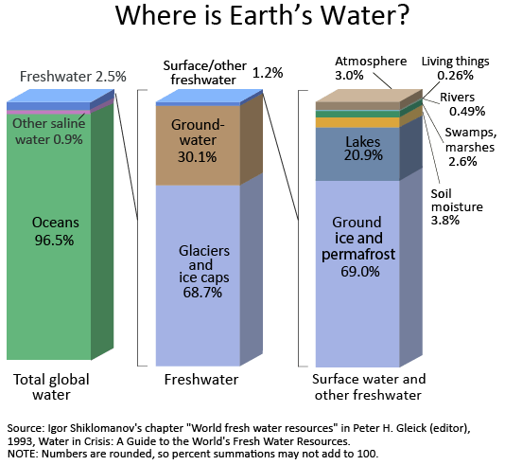
water
97.5% of the water on the earth is sea water
0.25% of the water can be used for human

Slide 9
Thank you all

